Slide 1

Control statements 2
Kia Babashahi Ashtiani
Programming in Java

Slide 2
Recap
Input and output
Formatters
Random and Math
Selection statements : if, else and nested if else

Slide 3
This time
Switch case
Repetition control statements
While
Do while
For

Slide 4
Switch
Switch is a multiple selection statement
Runs different actions based on different values of an integral expression.
First compute the integral part if it needs to be computed
Then check for different cases of which might happen.
For each case do something then break out of it.
If none of the cases is true do something by default.

Slide 5
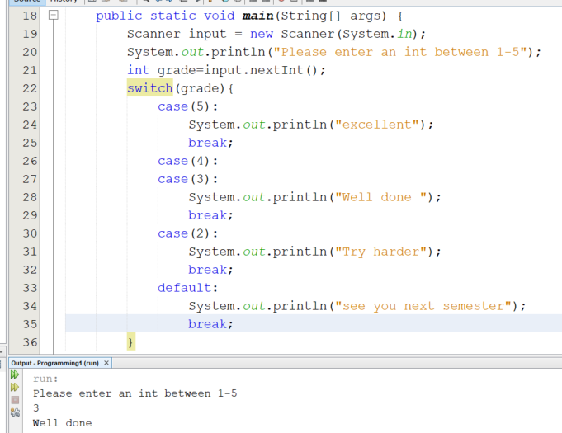
Switch Code
Pay attention that case 3 and 4 are being executed printing the same message. The break statement is important.
Break will be used much more in repetition statements.
The name is on it, it breaks a cycle.

Slide 6
More on switch case
Try to implement using nested if else rather than switch.
Avoiding break causes error.
In your code remove the break after 3 and then insert 3 see what you will get.
Try the same block of code but this time read a string and check for “5”, “4”,… see if it works. (it should work).
Switch is usually used with integers, chars and shorts.
Try double, what do you see?

Slide 7
If else double selection
Another thing that I don`t use and don`t suggest using but it is good to know.
Ternary operator (?: ) the following takes three arguments. condition?: which is and works as following:
?: create a conditional statement. So if the condition is true it executes what is between ? And : else it will execute what is after
System.out.println(grade==1?”failed”:”pass”);
Use nested if else

Slide 8
Repetition control statements : While
You have seen this in your flowchart classes.
While the user enters an even number, read more numbers.
While there is gasoline in the tank, move.

Slide 9
While
It consists of two parts.
A condition and a body.
While the condition is satisfied you continue executing what is inside the body.
Once the condition is false, jump out of the loop.

Slide 10
Example
Find all the even numbers between 0 and 100.
Break it down:
Need to start from one and reach 100.
If you are between 0,100 check if the number is even or not and print it.
OR: Just generate even numbers:

Slide 11
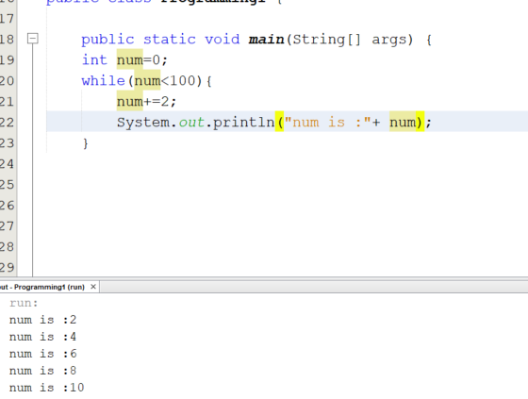
While 1
Only generates even numbers

Slide 12
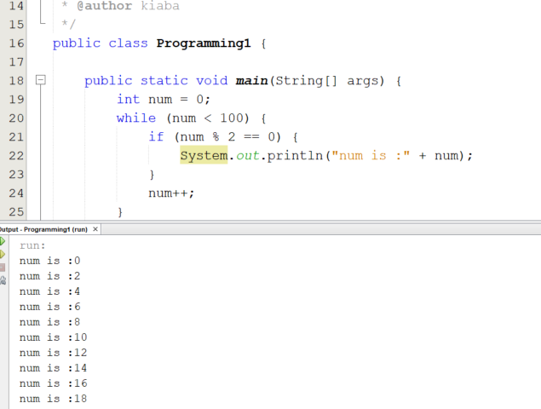
While 2
Another algorithm that integrates an if inside a while

Slide 13
Question: Infinite loops
What would happen if you remove n++ in the second code or n+=2 in the first one?
Try it.
You will see the code will run for ever. This is a problem referred to as infinite loops.
Never forget to increment or decrement or change the counter.

Slide 14
Different algorithms
There is usually more than one way to solve a problem.
There can be multiple algorithms.
What you saw now is an example of having two different algorithms to solve the same problem.

Slide 15
Example with break
The code starts by generating a random integer between 0 and 50.
If the number is not divisible by 5 it will generate another random number and print it.
The process goes on until we see a number divisible by 5.
While in the loop If the number generated is divisible by 7 break and exit immediately.

Slide 16
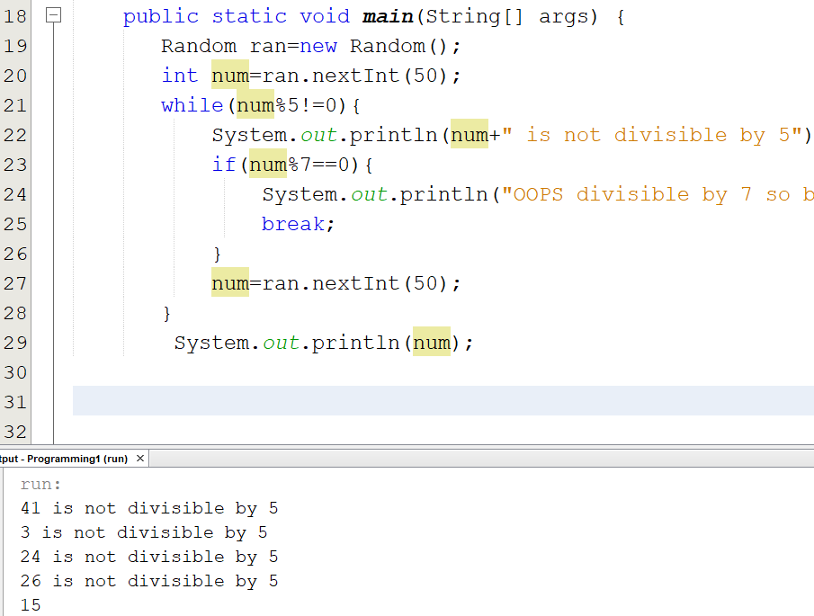
Break
Generates a random number first.
If the number is not divisible by 5 does what is inside the body of the while statements.
If the number is divisible by 7, it breaks the loop. Meaning that it will get out of the loop and not run the rest of the body of the loop.

Slide 17
Counter Control repetition
A variable is called a counter or counter control variable to control the number of executions of the code.
Counter control repetitions go through a certain number of iterations known a priory.
Let's say you have a class of 10 students, you need to insert the grades of each one of these ten students to computer their average grade. Hence, you know in advance that the number is 10 and you need a counter to read keep track of the number of read elements.
Remember the counter in the flowchart section?

Slide 18
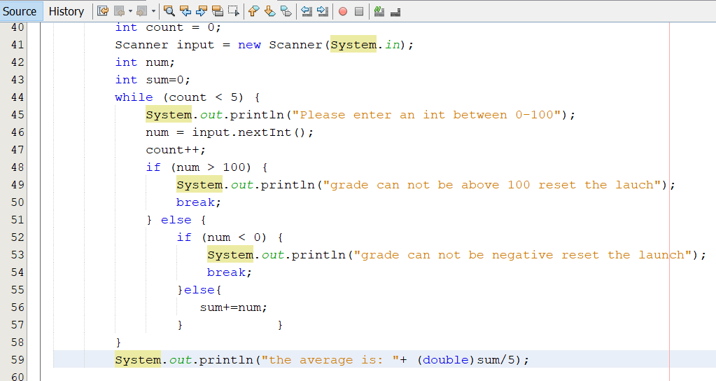
Counter example1
Count is the counter control variable.
(Double) is used to cast. int/int =int but avg is double.
Break is used if grades are inserted in an incorrect manner.

Slide 19
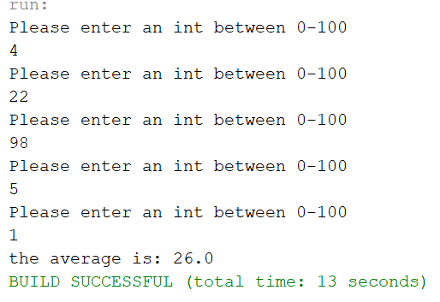
Output

Slide 20
Sentinel Controlled repetition
Remember when we asked the user to keep entering numbers until they enter -1 or a negative number?
In the flowcharts we checked if the input equals a certain number i.e., -1 or not, if it did not, we continued reading more numbers otherwise we stopped.
This is an application of what we call sentinel control repetition.
Unlike the counter control example you don`t count but you wait until a condition has been met.

Slide 21
Sentinel controlled repetition 2
Here, we first initialize, then read the input and then update the condition if necessary.
No need to know the count in advance.
The user can input as many numbers as they want and the average would be computed until the sentinel has been entered.

Slide 22
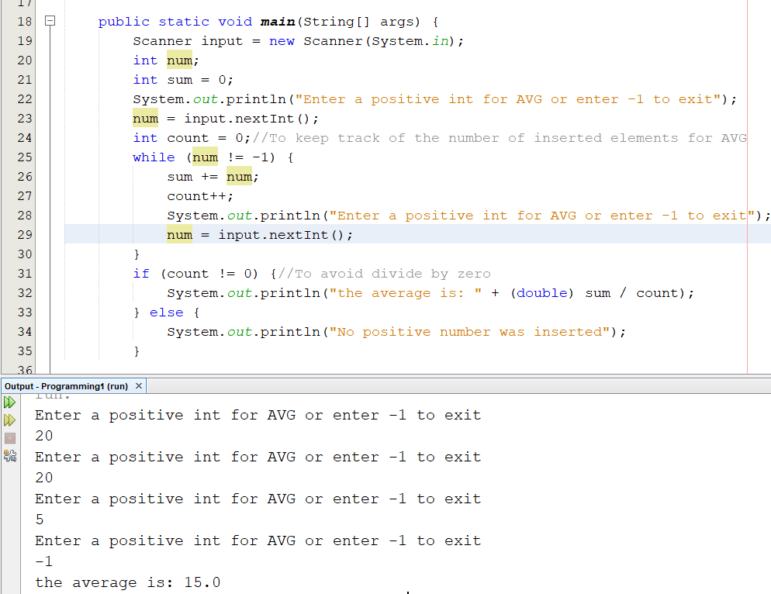
Example
Compute the avg of the numbers the user inputs until they type -1.
The sentinel is -1
Counter is used to keep track of the count of the numbers.
The last if else has been inserted to avoid divide by zero

Slide 23
Infinite loop 2
What will happen if you delete the code at line 29.(input.nextInt()) in the while body?
Another infinite loop will start and that will result in an error.
So make sure you are updating the variable. Because the while keeps running until you enter a number that would violate the condition.

Slide 24
Summary
Switch case
Different versions of if else statements
While statements
Counter control and sentinel control repetition statements.

Slide 25
Next time
Increment and decrement
Continue
Do while
For

